Slide 1
Comprehensive Exam
Name : Sharmila Mani
ID : Ph2020017
Committee Members : Prof. V Ramasubramanian
Prof. Neelam Sinha
Prof. Madhav Rao

Slide 2
1. Given a 1D time signal such as EMG signal acquired from two channels (two electrodes) separately, for 1000 seconds from an individual with sampling rate of 200 Hz for two physically separate events being repeated continuously. Consider five handcrafted features are extracted from the individual 1D time signal for each channel for a moving non-overlapping window of size 100 samples, where both channels are equally important
How do you intend to develop the classification model using any of the traditional Machine learning techniques? CNN or MLP models are not required for this analysis.
Classification Model can be developed using multistep procedure that include Data Collection, Data Preparation, Model Selection, Model Training, Model Evaluation, Parameter Tuning and Model Deployment
Data Collection – is where EMG signal is acquired from two channels when the classification task is performed
Data Preparation – helps to clean the data and visualize to understand the relationship between variables and parameters
Feature Extraction – helps to preserve the required information from raw data
Model Selection – the algorithm suitable for the classification can be chosen to train the data
Model Training – involves training the prepared data using the chosen algorithm. Algorithm learns the patterns in classification task from data provided and predicts the unseen data
Model Evaluation – Trained model can be evaluated using the data unseen to identify how well the algorithm performs
Parameter Tuning – helps to fine tune the model to provide best accuracy
Model Deployment – now the model can be used for classification task and it can help us to make well formed decision on a new data

Slide 3
b) Analyze the importance of the duration of the analysis-window (frame-size, e.g. 100 samples as indicated above or other possible choices of this size) - with respect to the desired time-resolution of labeling the signal and the trade-off in extracting reliable features (such as time-domain / spectral features) possibly calling for longer frame-sizes.
The total duration of the experiment here involves 1000 seconds and features are extracted from 100 samples.
Given 1000 seconds and sampling rate of 200Hz the total number of samples generated in a trial for single electrode is 2*10⁵ samples. In longer frame size extracting only five features from 200000 samples provides only the general information. The signal features has a large variability in the given time based on action performed which remains not captured. Based on action performed and its time taken, the complete trial can be split in shorter frames like 100, 200, 400 etc and analysis can be performed to identify which short frame size best suits for the given classification task.
In case of stationary signal, the longer frames generally covers the feature information due to less variability in the action. However, in case of dynamic signals, the short frames helps to identify signal variation and dynamicity present generating features on the complete signal masks information present.
c) Analyze the discriminatory power of any feature-set (e.g. the 5 handcrafted features referred above), and how one can
i) ensure the most optimal discriminability via feature-engineering (refer to classical feature-selection techniques),
The data collected can be normalized using mean of the trial. Other feature engineering techniques like standardization, handling null and outliers can also be applied. The extracted features can be plotted against the given classes using TSNE/ PCA to crosscheck the maximum discriminability between classes and improvise the features
ii) adapt means towards how best to 'hand-craft' the features, i.e., what considerations go into deciding on the choice of features (time/frequency domain or other kinds, if any).
Time domain features are calculated from the amplitude of the signal and helps to identify stationary features like mean, variance, standard deviation, skewness, kurtosis etc. Frequency domain features helps to identify discriminability of the frequency variation in the actions by features like mean frequency, median frequency, signal to noise ratio etc.

Slide 4
d)Since the available data is limited, in order to establish generalizability, Use Hypothesis Testing to establish the statistical significance of the results obtained, for a reasonable value of parameters.
Hypothesis Testing is done to confirm our observation on the population using sample extracted from the population. It helps to find how the trained model performs on the data. The data used for evaluation can be ensure to have different classes and significance of alternate hypothesis can be defined. Type of test perform can be determined and once evaluation is done test-statistics can be used to calculate p-value. Type I and Type II error can be determined and accuracy score, Sensitivity, True Positive, False Positive and F1 score can be determined.

Slide 5
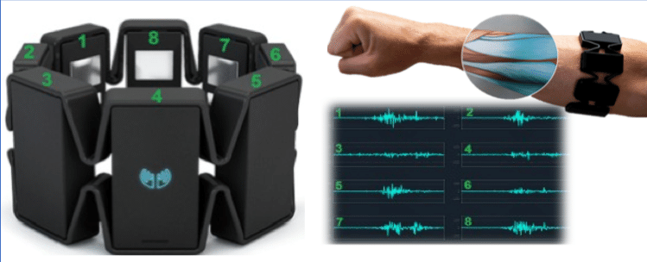
Please discuss and explain the CNN and Random-Forest method employed for your research work towards identifying finger-based keypress using surface-based EMG signals in detail. Highlight the major results accomplished so far in the research work.
Objective: To decode continuous playing of musical instruments like electronic musical keyboard, piano using EMG signal from hands.
Data Collection :
C | D | E | F | G
T | I | M | R | L
Key Press : 10 second
#Trials : ~31 trials for each class
#samples/trial : 2270
#classes : 5
Myo armband : 8 Electrode data
Using Bluetooth and MyoConnect

Slide 6
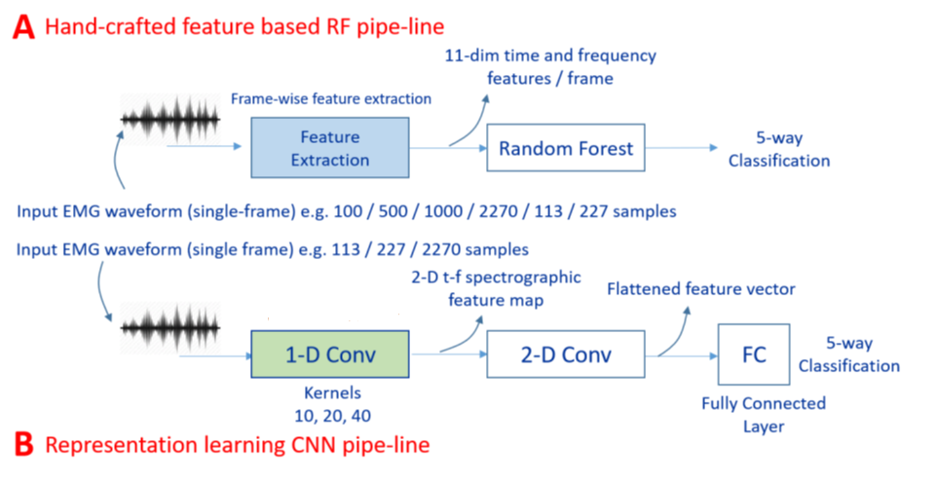
Architecture Pipeline:

Slide 7
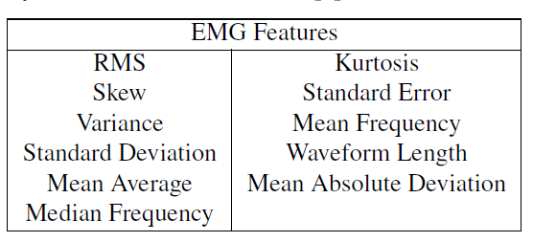

Analysis: RF Pipeline
Feature Extraction
Standard Scaler
LDA
Classification Accuracy for different frame size using All 8-electrode EMG data in RF pipeline.
RF
Experiments on CNN: #1, #4 and #7
Single Electrode Full Frame EMG data in RF pipeline.
Electrode #1 and #7 : highest, #4 and #6 : lowest

Slide 8
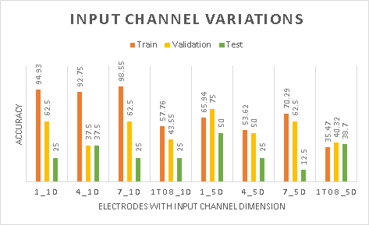
Analysis: CNN Pipeline
Single vs Multiple Channel, Short and Full Frame Analysis, Different Kernel Size
Data Split : train:validation:test , 8:1:1 and 7:1:2
Classification accuracy of key press classes using single electrode (#1, #4, #7) data, and all electrodes (1To8) data when applied to single channel and multiple 5 channels of CNN input in CNN pipeline

Slide 9
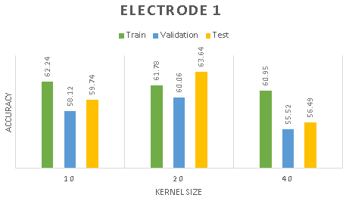
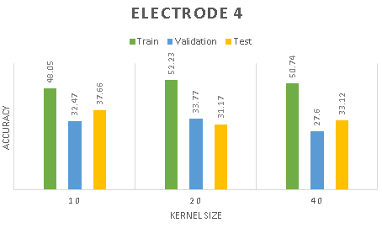
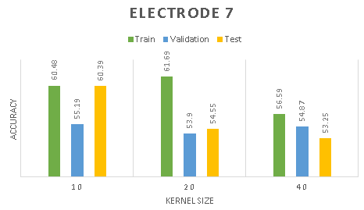
Analysis: CNN Pipeline
CNN train, validation and test accuracy for varying kernel sizes and frame size of 227 for single EMG Electrodes (#1, #4 and #7) data.

Slide 10
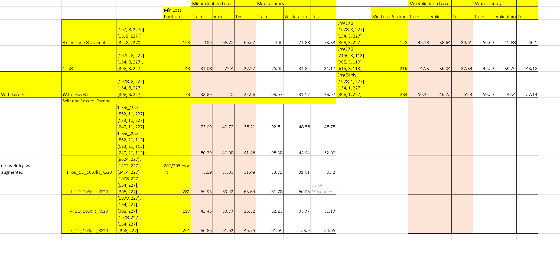
MultiChannel vs Single Channel

Slide 11
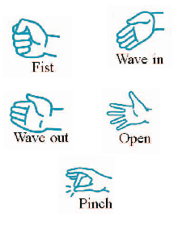
Ongoing: CNN Analysis for Myo and Standard Data Gestures
Myo Gestures
Six Grasping Gestures DataSet
To compare
- raw features [11D, opensmile] vs Spectral Analysis vs CNN
- long press of 10 second vs instant key press vs multiple key press
Future:
- Key Press to Continuous Decoding
- Single user to Multi user

